Slide 1
How to Determine All Possible Project Combinations
Where there are more than 1 projects under consideration
CSE 2315

Slide 2
The Process Using a Base 2 Truth Table
For each project under consideration it can be selected or not selected
We may designate the state when selected as a “1”, and
When not selected the state can be defined as a “0”
Based upon this we are dealing with base 2
A binary count can help identify all the possible combinations of project groupings
If there are two projects under consideration there are 2 to the 2nd power possible groupings to be considered:
2² = 4 possible project groupings
This includes the “do nothing” alternative where none of the projects are selected

Slide 3
The Process Using a Base 2 Truth Table
Consider projects “A” and “B”, what might a truth table depicting all the possible combinations of selections look like?
Example: Candidate Projects
A B
Count 2¹ 2⁰
0 0 0
1 0 1
2 1 0
3 1 1
Group 0 – Do Nothing, No Projects are Selected
Group 1 – Only Project B is Selected
Group 2 – Only Project A is Selected
Group 3 – Both Projects A & B are
selected
Two Projects,
4 possible
Combinations
Of Select or Not
Select
Note: “0” designates a project has not been selected
and a “1” designates a project is selected for consideration

Slide 4
What if there are 3 Projects - A, B, & C?
There would be 2³ = 8 possible groupings of Select – Don’t Select
2² 2¹ 2⁰
Count A B C Comment
0 0 0 0 Do Nothing
1 0 0 1 Select Prj C
2 0 1 0 Select Prj B
3 0 1 1 Select Prj B & C
4 1 0 0 Select Prj A
5 1 0 1 Select Prj A & C
6 1 1 0 Select Prj A & B
7 1 1 1 Select Prj A, B, & C
8 possible
Select –
Don’t Select
Groupings
The question now is are we done? No, we must now apply any constraints
Related to dependencies, mutual exclusivity, and budget

Slide 5
Problem Statement:
We are considering 4 projects – A, B, C, and D with the following constraints:
Constraint 1 (C1): We know that if project A is selected then so must project D.
Constraint 2 (C2): We also know that projects B and C are mutually exclusive alternatives, meaning if B is selected, then C cannot be selected. And if C is selected then B cannot be selected.
Constraint 3 (C3): Our company has a total investment budget for the year of not to exceed $3 million.
Constraint 4 (C4): We also know that we must spend the budget or lose it to corporate headquarters, so the “do nothing” option is not a consideration.
Having gone through preliminary evaluations with our Engineering and Finance teams we have determined that the Project Costs and respective returns on the investment are as defined below:
Project A will cost $1.5 million, expected return on investment is 5%
Project B will cost $1.3 million, expected return on investment is 7%
Project C will cost $0.5 million, expected return on investment is 6.5%
Project D will cost $0.7 million, expected return on investment is 8%
What are the combinations of projects that the above dictates can be considered going forward in our investment alternative evaluation process?

Slide 6
Building the Table of possible groupings:
Group 2³= 8 2²= 4 2¹= 2 2⁰= 1
A B C D Comments
0 0 0 0 0
1 0 0 0 1
2 0 0 1 0
3 0 0 1 1
4 0 1 0 0
5 0 1 0 1
6 0 1 1 0
7 0 1 1 1
8 1 0 0 0
9 1 0 0 1
10 1 0 1 0
11 1 0 1 1
12 1 1 0 0
13 1 1 0 1
14 1 1 1 0
15 1 1 1 1

Slide 7
Now Apply the Constraints:
Group 2³= 8 2²= 4 2¹= 2 2⁰= 1
A B C D Comments
0 0 0 0 0 Violates C4
1 0 0 0 1 Ok
2 0 0 1 0 Ok
3 0 0 1 1 Ok
4 0 1 0 0 Ok
5 0 1 0 1 Ok
6 0 1 1 0 Violates C2
7 0 1 1 1 Violates C2
8 1 0 0 0 Violates C1
9 1 0 0 1 Ok
10 1 0 1 0 Violates C1
11 1 0 1 1 Ok
12 1 1 0 0 Violates C1
13 1 1 0 1 Violates C3
14 1 1 1 0 Violates C1, C2 & C3
15 1 1 1 1 Violates C2 & C3

Slide 8
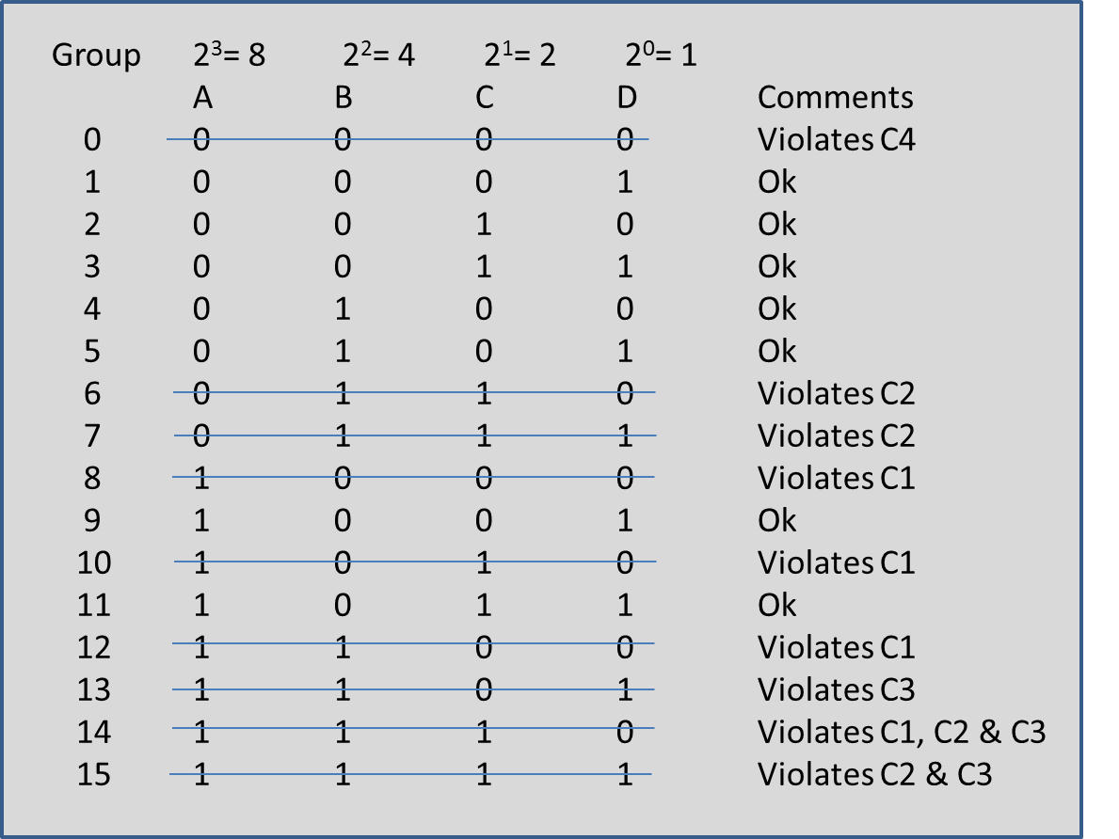
Based upon the rules what are the viable groupings that can now be considered going forward?
Applied the TVOM
(MARR)
What are the viable groupings that can now be considered going forward?
Group 1 Project D
Group 2 Project C
Group 3 Projects C & D
Group 4 Project B
Group 5 Projects B & D
Group 9 Projects A & D
Group 11 Projects A, C, & D
What have we not done in our investment analysis?

Slide 9
Suppose there was a 5th constraint that stated for a group of programs to go forward it must have an aggregated rate of return equal to or better than 7%. Does this affect the groups of programs that are viable for final disposition?
From the previous constraints analysis we have the following viable groups of programs
Group 1 Project D
Group 2 Project C
Group 3 Projects C & D
Group 4 Project B
Group 5 Projects B & D
Group 9 Projects A & D
Group 11 Projects A, C, & D
How do we determine which groups are acceptable?
The answer is those that meet constraint 5.
Now we must calculate what the aggregated rate of return is for each grouping

Slide 10
Calculating the Aggregate Rate of Return (RR)
Example Calculation for RR:
RR for Group 11 is calculated in this manner
RR₁₁ = Total Earnings/Total Investment x 100%
= [(1,500,000 x 0.05 + 500,000 x 0.065 + 700,000 x 0.08)/(1,500,000 + 500,000 + 700,000)] x 100%
= 6.06%
Group Projects in Group Total Investment Total Return RR
1 Project D $ 700,000 $ 56,000 8%
2 Project C $ 500,000 $ 32,500 6.5%
3 Projects C & D $1,200,000 $ 88,500 7.34%
4 Project B $1,300,000 $ 91,000 7%
5 Projects B & D $2,000,000 $147,000 7.35%
9 Projects A & D $2,200,000 $131,000 5.95%
11 Projects A, C, & D $2,700,000 $163,500 6.06%

Slide 11
Now Assessing against Constraint 5 which states the Group of Programs Must have a rate of return of 7% or better.
Group Projects in Group Total Investment Total Return RR
1 Project D $ 700,000 $56,000 8%
2 Project C $ 500,000 $32,500 6.5%
3 Projects C & D $1,200,000 $88,500 7.34%
4 Project B $1,300,000 $91,000 7%
5 Projects B & D $2,000,000 $147,000 7.35%
9 Projects A & D $2,200,000 $131,000 5.95%
11 Projects A, C, & D $2,700,000 $163,500 6.06%
Decision is the selection of Group 5 since it uses the most of
The “must spend investment budget” and meets the acceptable Rate of return. But there’s more to consider, what do you think about this selection?
A word of caution is required here since Group 3 and Group 5 have returns that are almost the same. In fact at this point the management team might want to do sensitivity analysis to see if the outcome is the same. If this does not clearly determine which group is best then the management team might review to see which investments have the greater risk and make a selection based upon the lowest risk investment. In either case further analysis would be require.

